Slide 1








ROS2 & ROS2 Navigation
ROS2 Topic C++ 编程
Mar-19 2023
https://github.com/duyongquan/ros2_tutorials
AibotBeginer ROS2
quandy2020@126.com

Slide 2

2
Outline
ROS2 Create Project
ROS2 发布者 & 订阅者
ROS2 Topic CLI tools
ROS2 Demo： Turtlesim
ROS2 Log & Debug
Summary

Slide 3
3
ROS2 Create Project

Slide 4
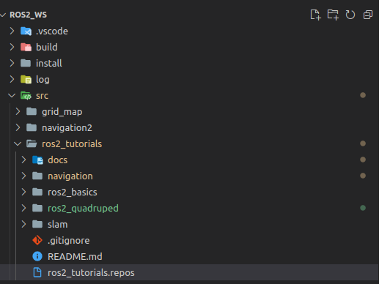
4
ROS2 Create Project
ROS2 Workspace
ros2_ws: 工作空间
build: 编译中间产物
install: 编译产物
log: 编译log
src: ros2 project
ros2 project 1
ros2 project 2

Slide 5
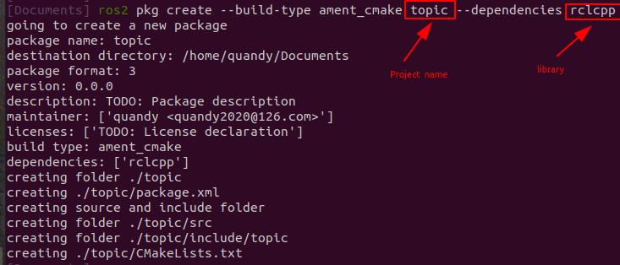
5
ROS2 Create Project
ROS2 Create a Project
ros2 pkg create --build-type ament_cmake topic --dependencies rclcpp

Slide 6
6
ROS2 发布者 & 订阅者

Slide 7
7
ROS2 发布者 & 订阅者

Slide 8
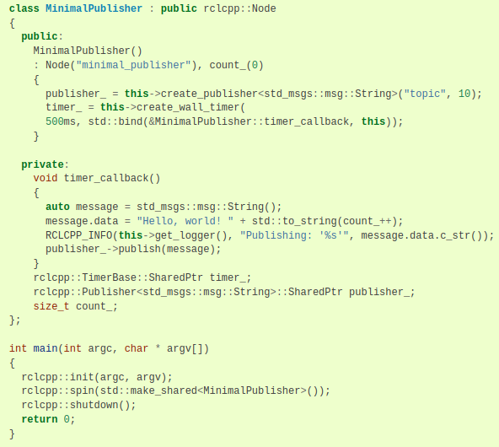
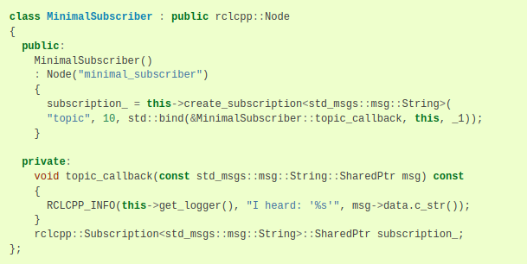
8
ROS2 发布者 & 订阅者
Publisher and Subscriber (C++)
A
B
A
ROS2 Publisher
B
ROS2 Subscriber

Slide 9
9
ROS2 Topic CLI tools

Slide 10
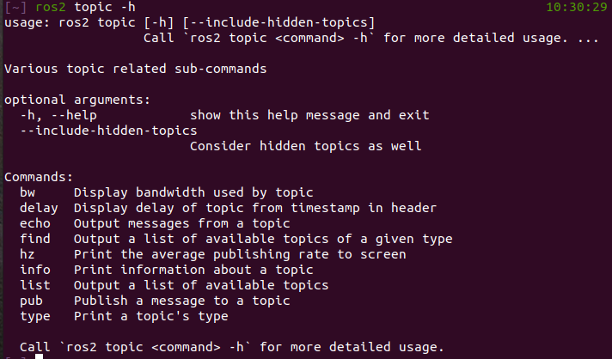
10
ROS2 Topic CLI tools
Topic CLI tool

Slide 11
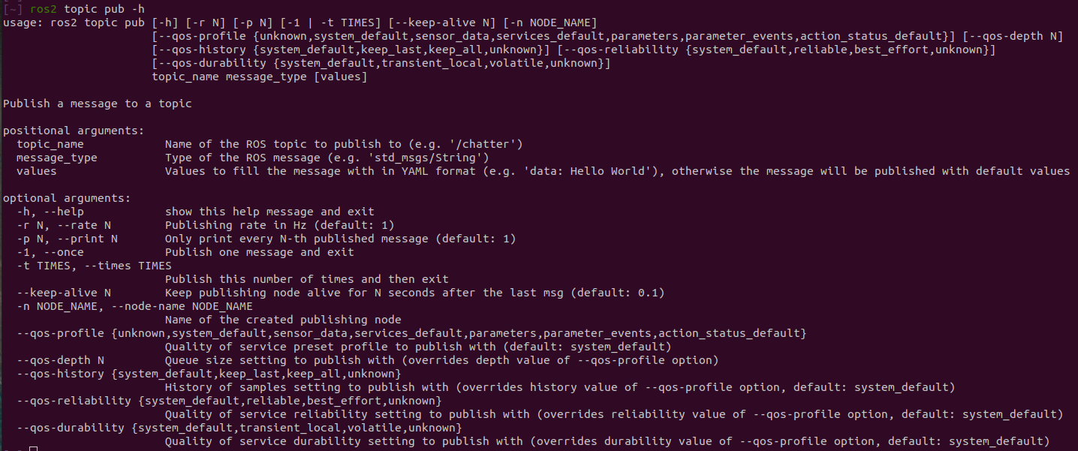
11
ROS2 Topic CLI tools
Topic CLI tool

Slide 12
ROS2 Demo Turtlesim
12

Slide 13
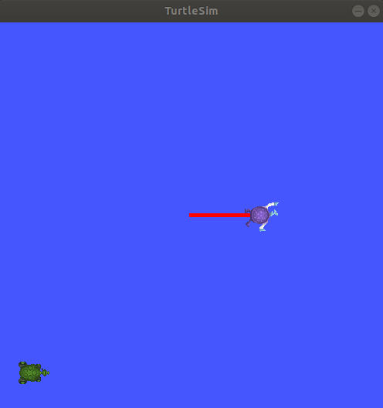
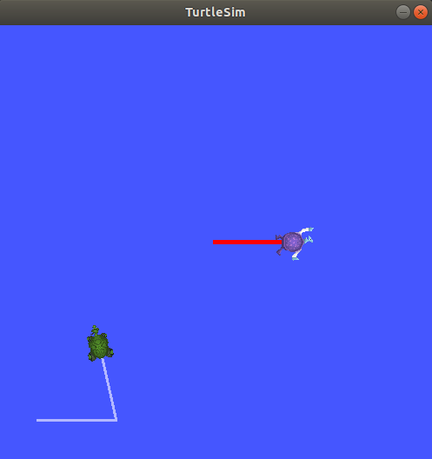
13
ROS2 Demo:Turtlesim

Slide 14
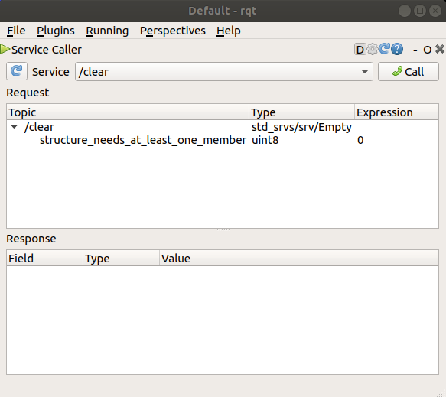
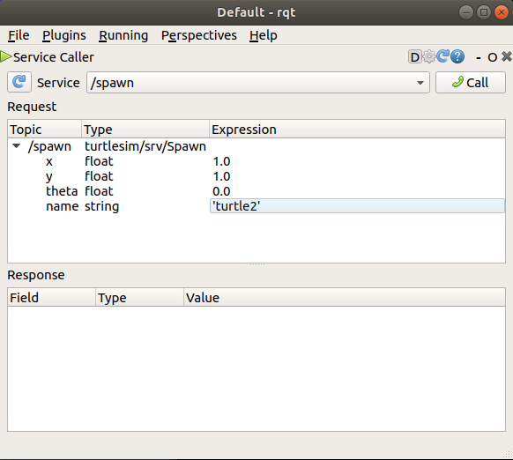
14
ROS2 Demo:Turtlesim

Slide 15
15
ROS2 Log & Debug

Slide 16
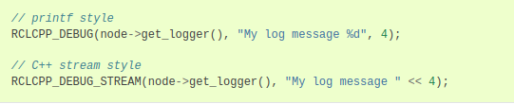
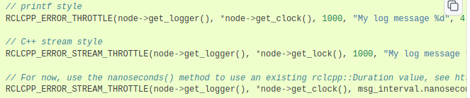
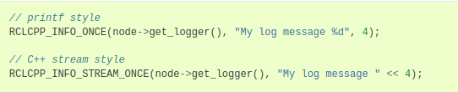


16
ROS2 Log & Debug
ROS2 Log
Basic logging
Logging throttled
Logging only the first time
Logging throttled all but the first time
Logging all but the first time

Slide 17
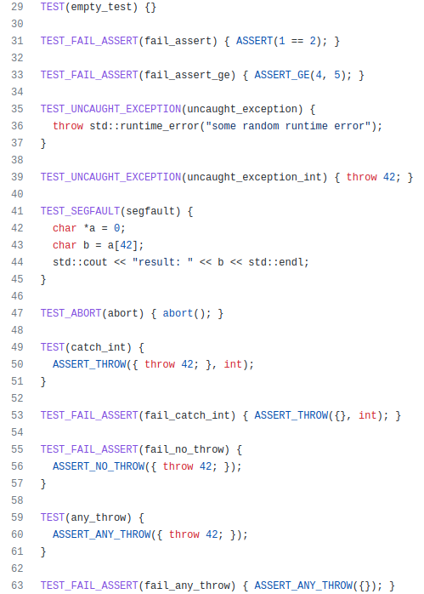
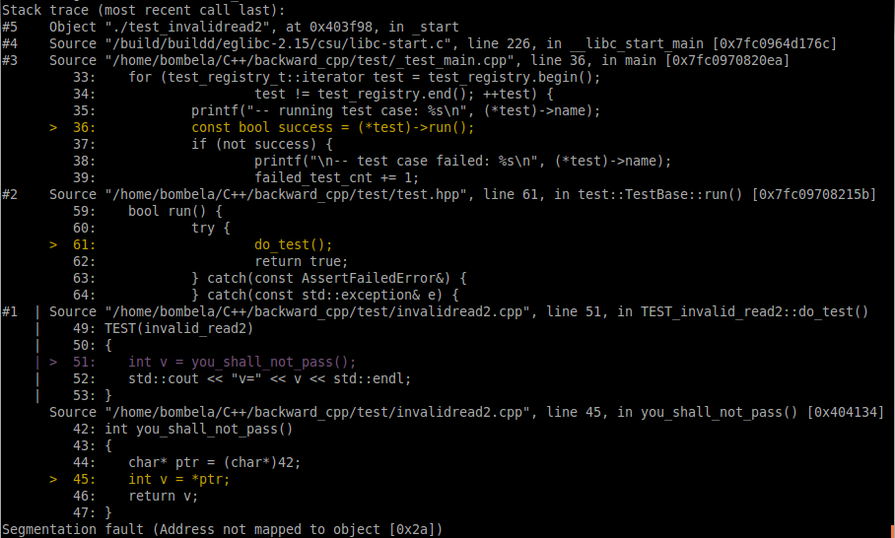
17
ROS2 Log & Debug

Slide 18
18
Summary

Slide 19
19
Summary
推荐网站
https://github.com/bombela/backward-cpp
https://github.com/duyongquan/ros2_tutorials

